Slide 1

Jack Arbuckle, Ben Scartz, David Sobek, Reuben Dayal, Ian Pezzella,
and George Cole
Playoff Bound?
Notes:
Ian

Slide 2

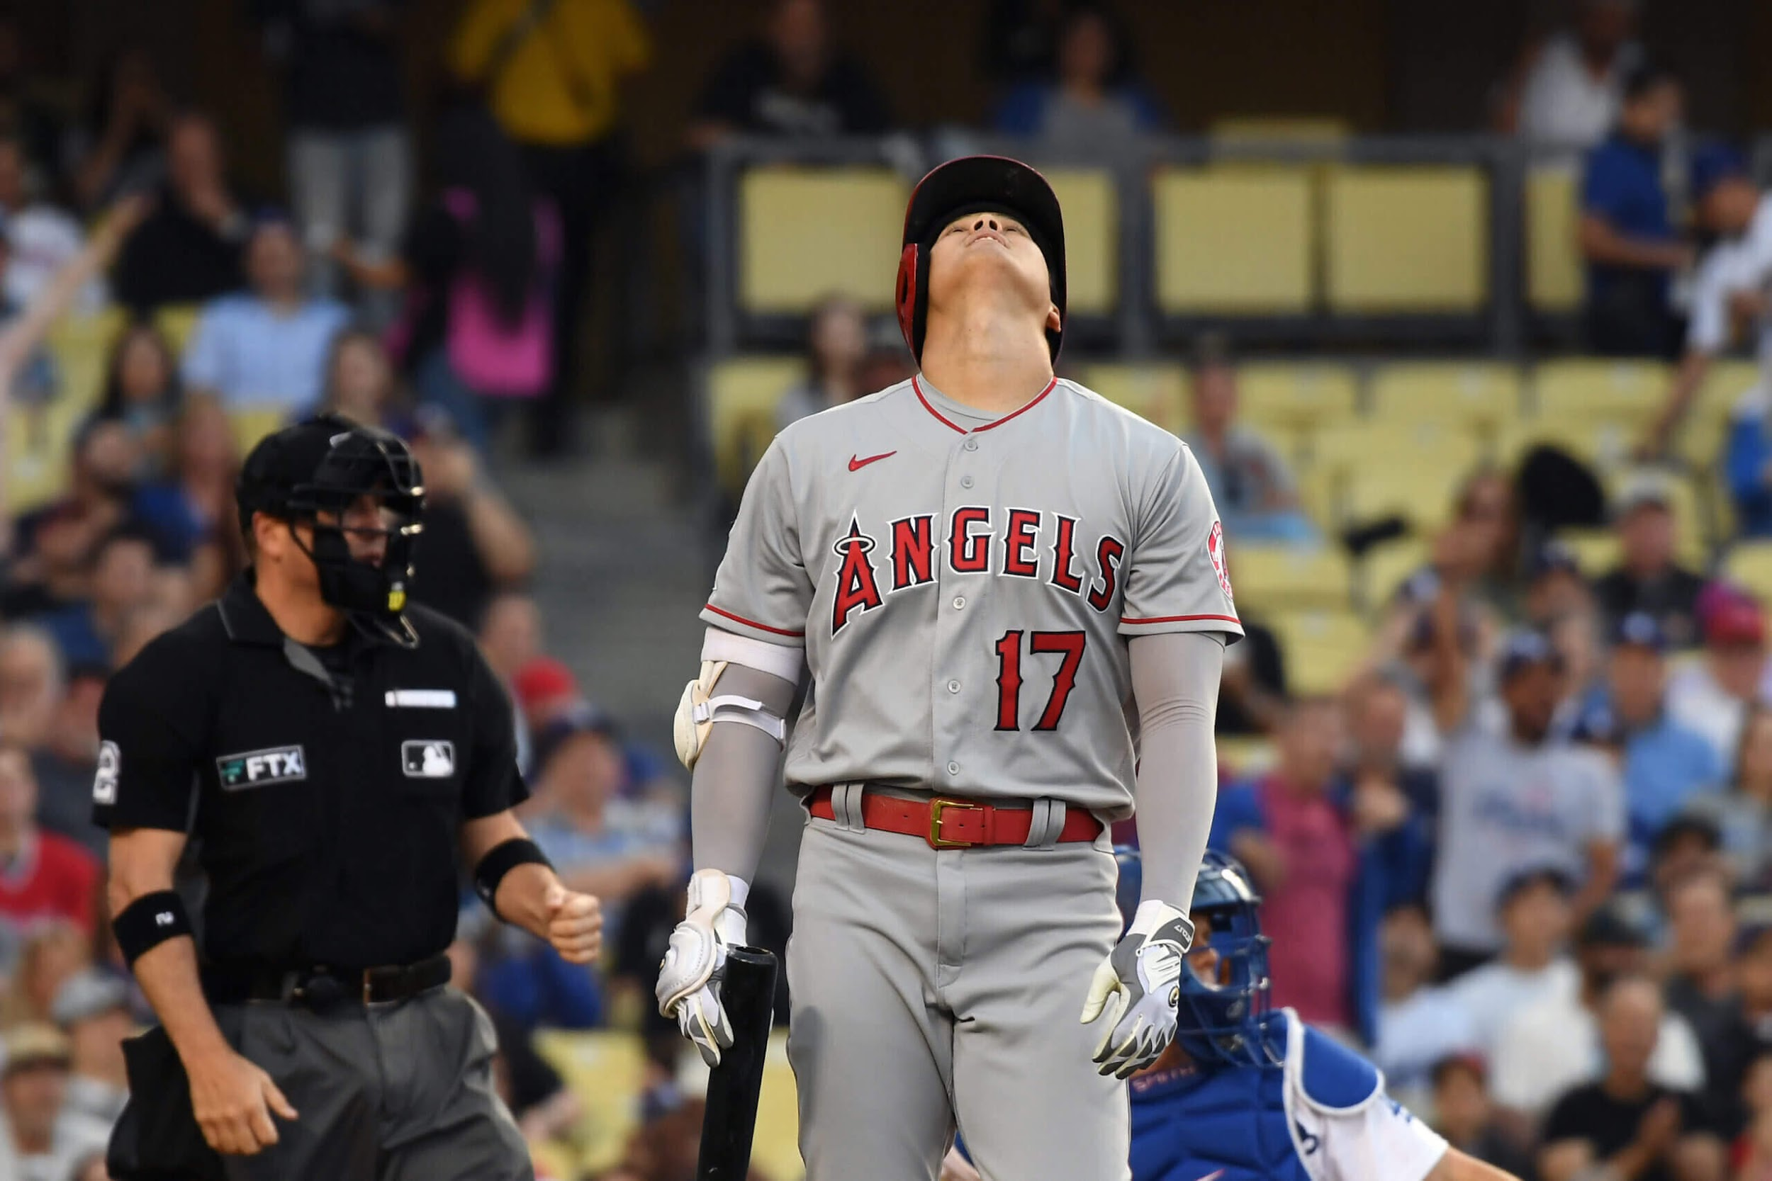
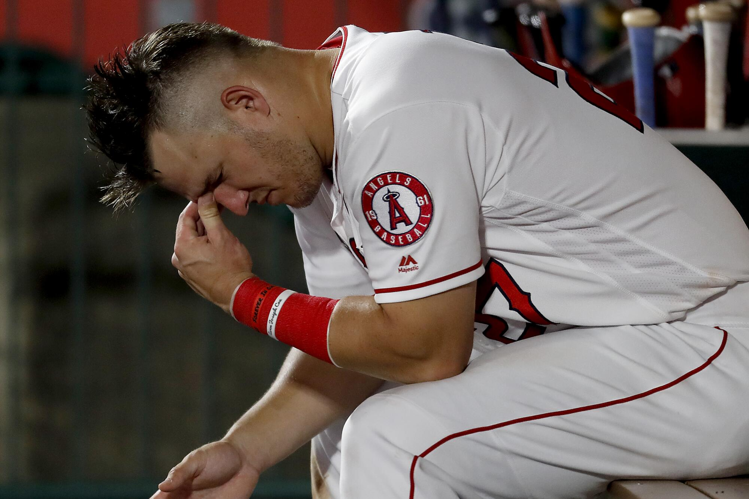
What’s going on with the Angels?
Missed playoffs last 9 seasons
Losing Record in all seasons since 2015
Top Ten in Payroll for the last 5 seasons
Roster includes:
3-Time MVP Mike Trout
2-time MVP Shohei Ohtani
Notes:
Ian

Slide 3
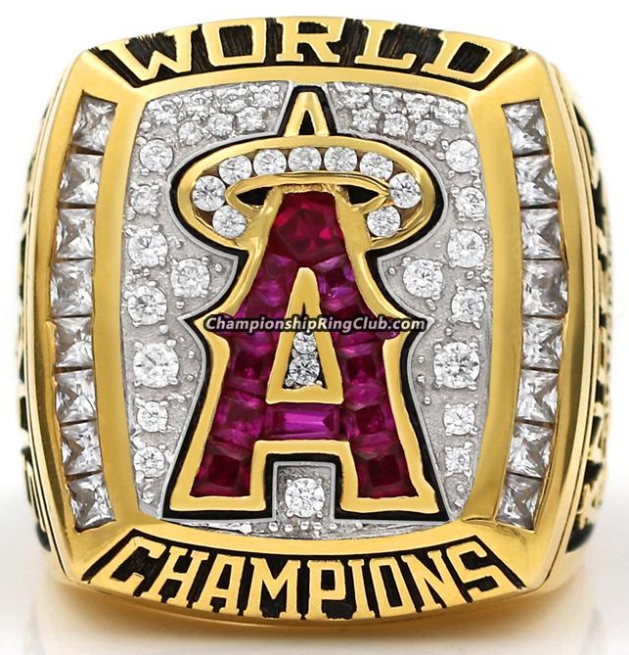

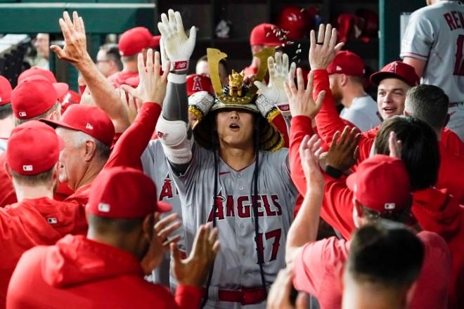
How to Fix this?
Highlight metrics to improve roster weaknesses
Present recommendations to the front office
what steps they can take to get the angels into the playoffs
Notes:
Ian

Slide 4
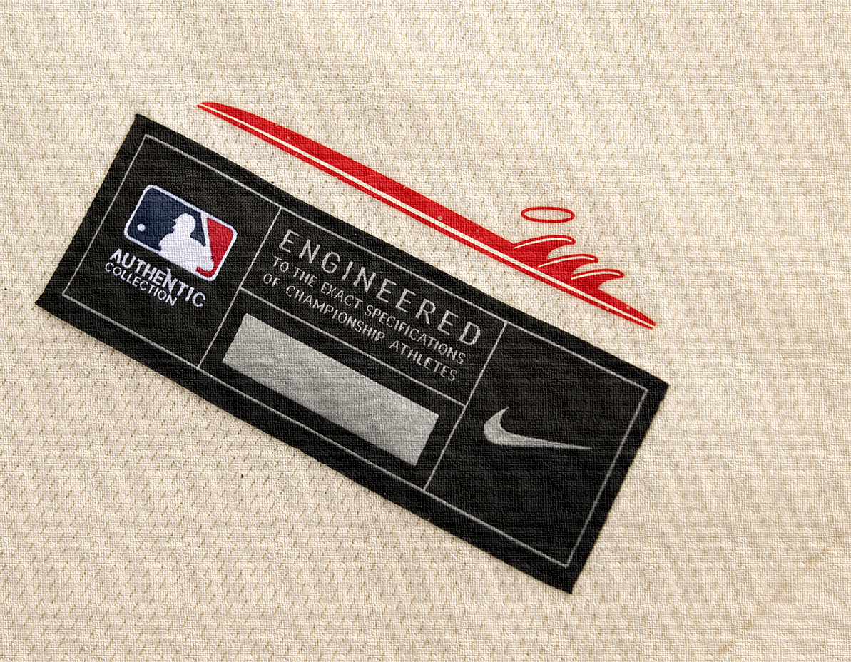

Hitting
Notes:
David

Slide 5
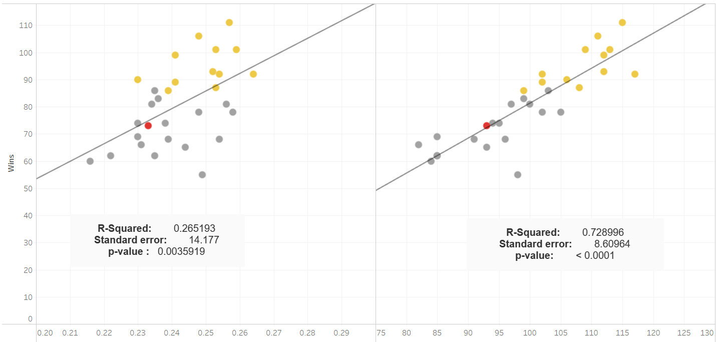
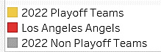
High Team Batting Average and OPS+ Lead to Winning (2022)
OPS+ has a stronger correlation with wins than batting average
Toronto Blue Jays
Highest OPS+
Highest AVG
92-70 Record
Playoff Bound
AVG
OPS+
Notes:
David

Slide 6
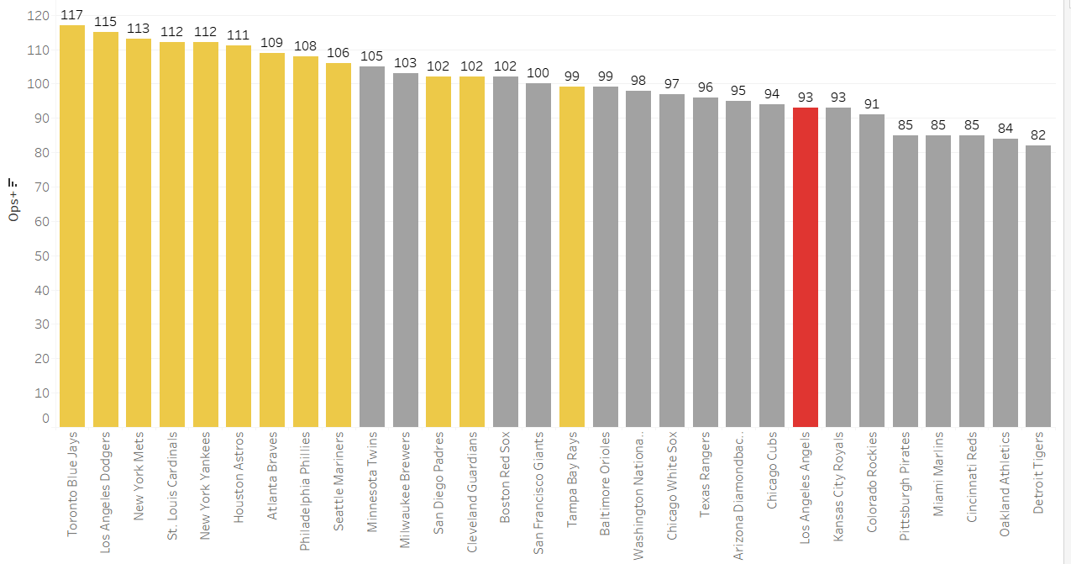

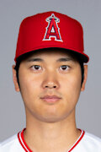

Angels Bottom Ten in the League in Team OPS+
Mike Trout
OF
OPS+ 176
Shohei Ohtani
P/DH
OPS+ 144
Andrew Velazquez
SS
OPS+ 52
Notes:
David

Slide 7
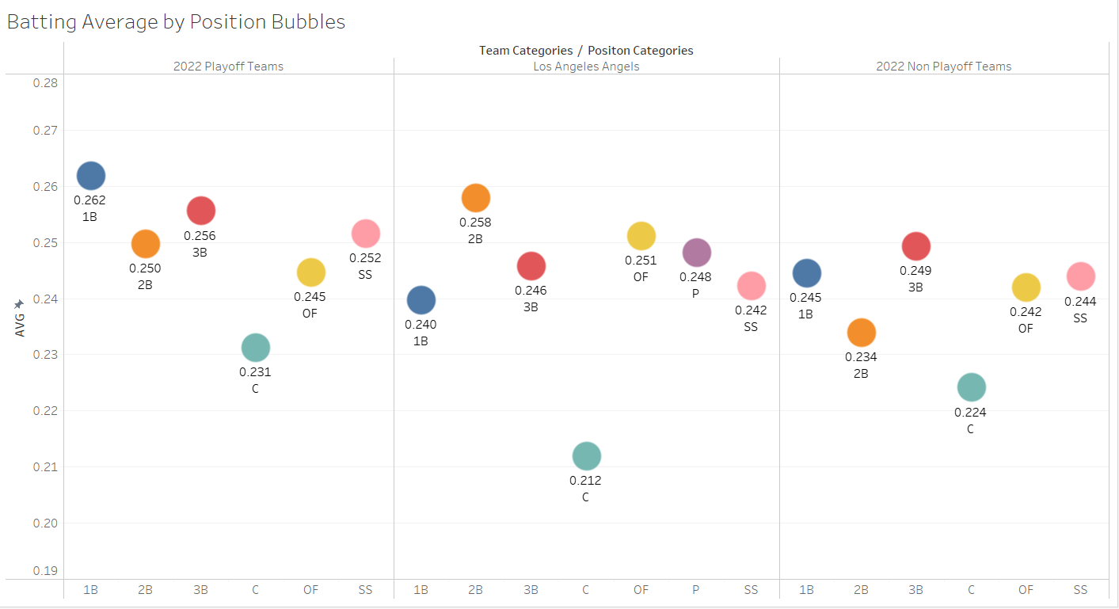




Angels lack offensive production at 1B, SS, and C
Max Stassi
C
AVG: .180
Catcher and Shortstop are defensive dominant positions
But Angels Catchers are well below league average
Need to upgrade 1B (Offensive first position) to match up better with Playoff Teams
Jared Walsh
1B
AVG: .215
Notes:
George

Slide 8
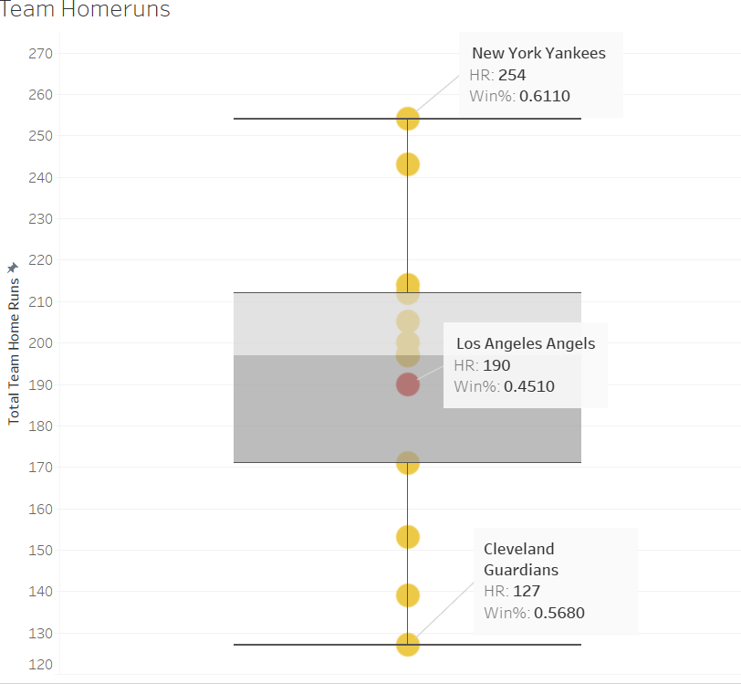


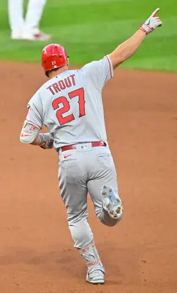

Angels do have Adequate Home Run Production
Angels are in the middle of playoff team average
HR production is a strength
Mike Trout
OF
HR: 40
Most on Team
Notes:
George

Slide 9


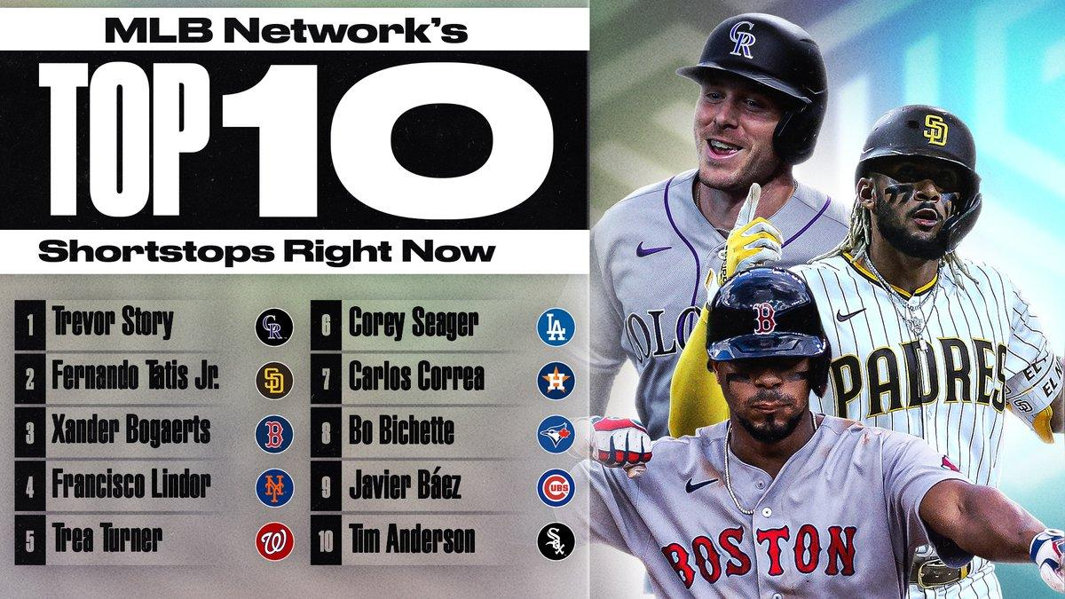
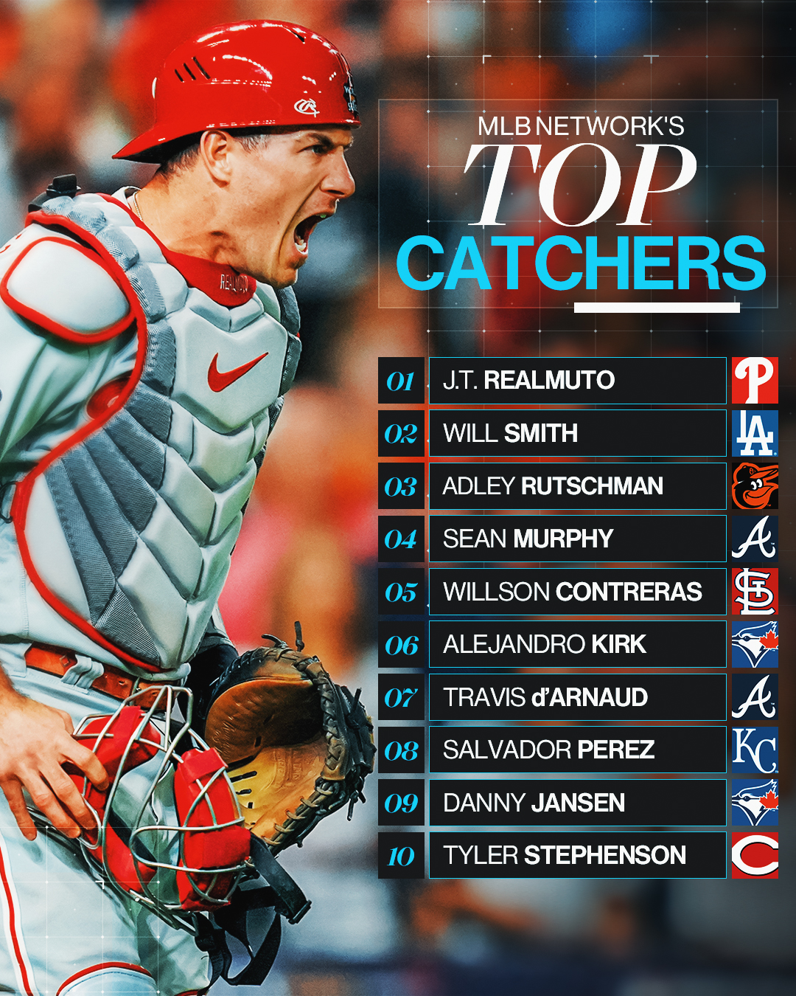
Recommendations for Hitting
Replace Jared Walsh at First Base
Focus on OPS+ for new 1B
Replace Andrew Velazquez at Shortstop and Max Stassi at Catcher
Focus on OPS+ but look at defensive ratings as well for new additions
Keep Outfielders and Second Baseman
Performing very well
Notes:
Jack

Slide 10
Pitching
Notes:
Ben

Slide 11
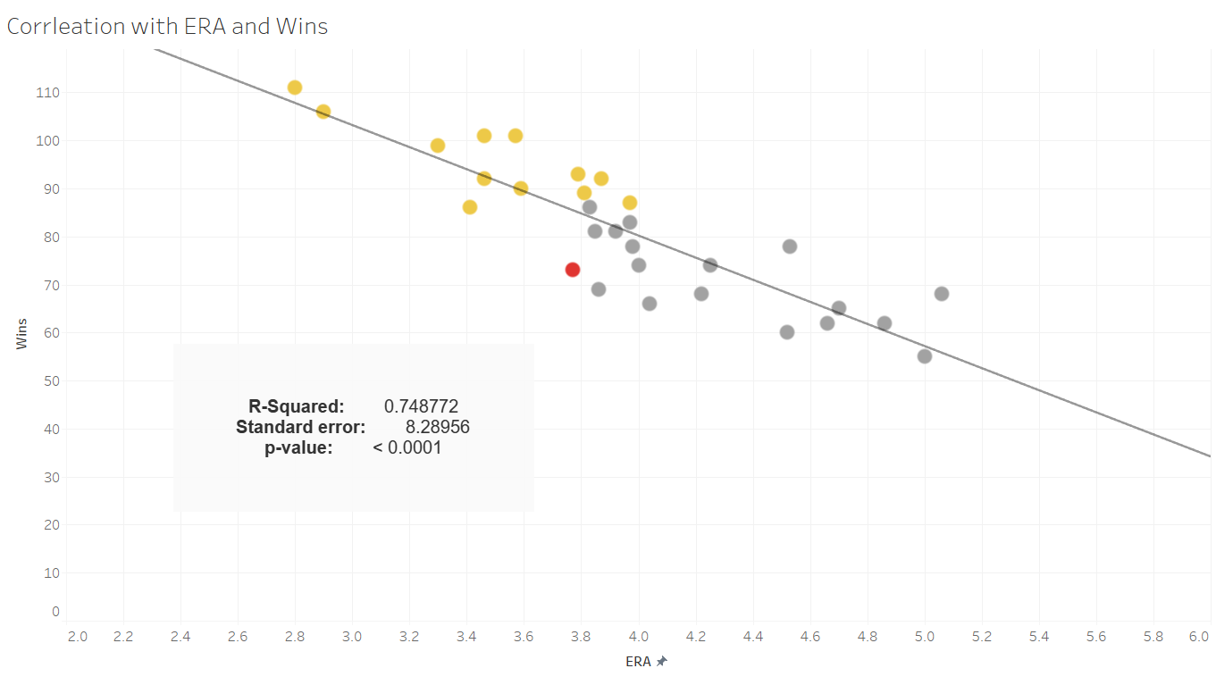
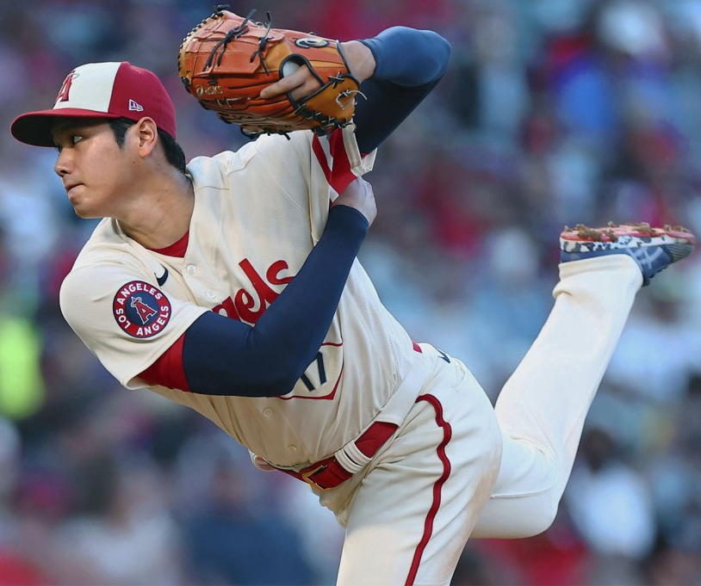
There is a strong correlation between Team ERA and win total
Shohei Ohtani
P/DH
ERA: 2.33
1st on Team
Notes:
Ben

Slide 12
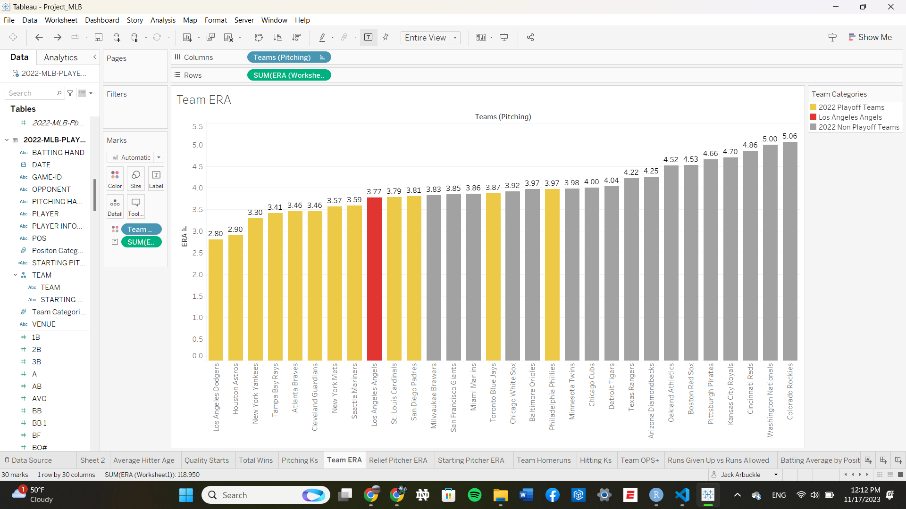

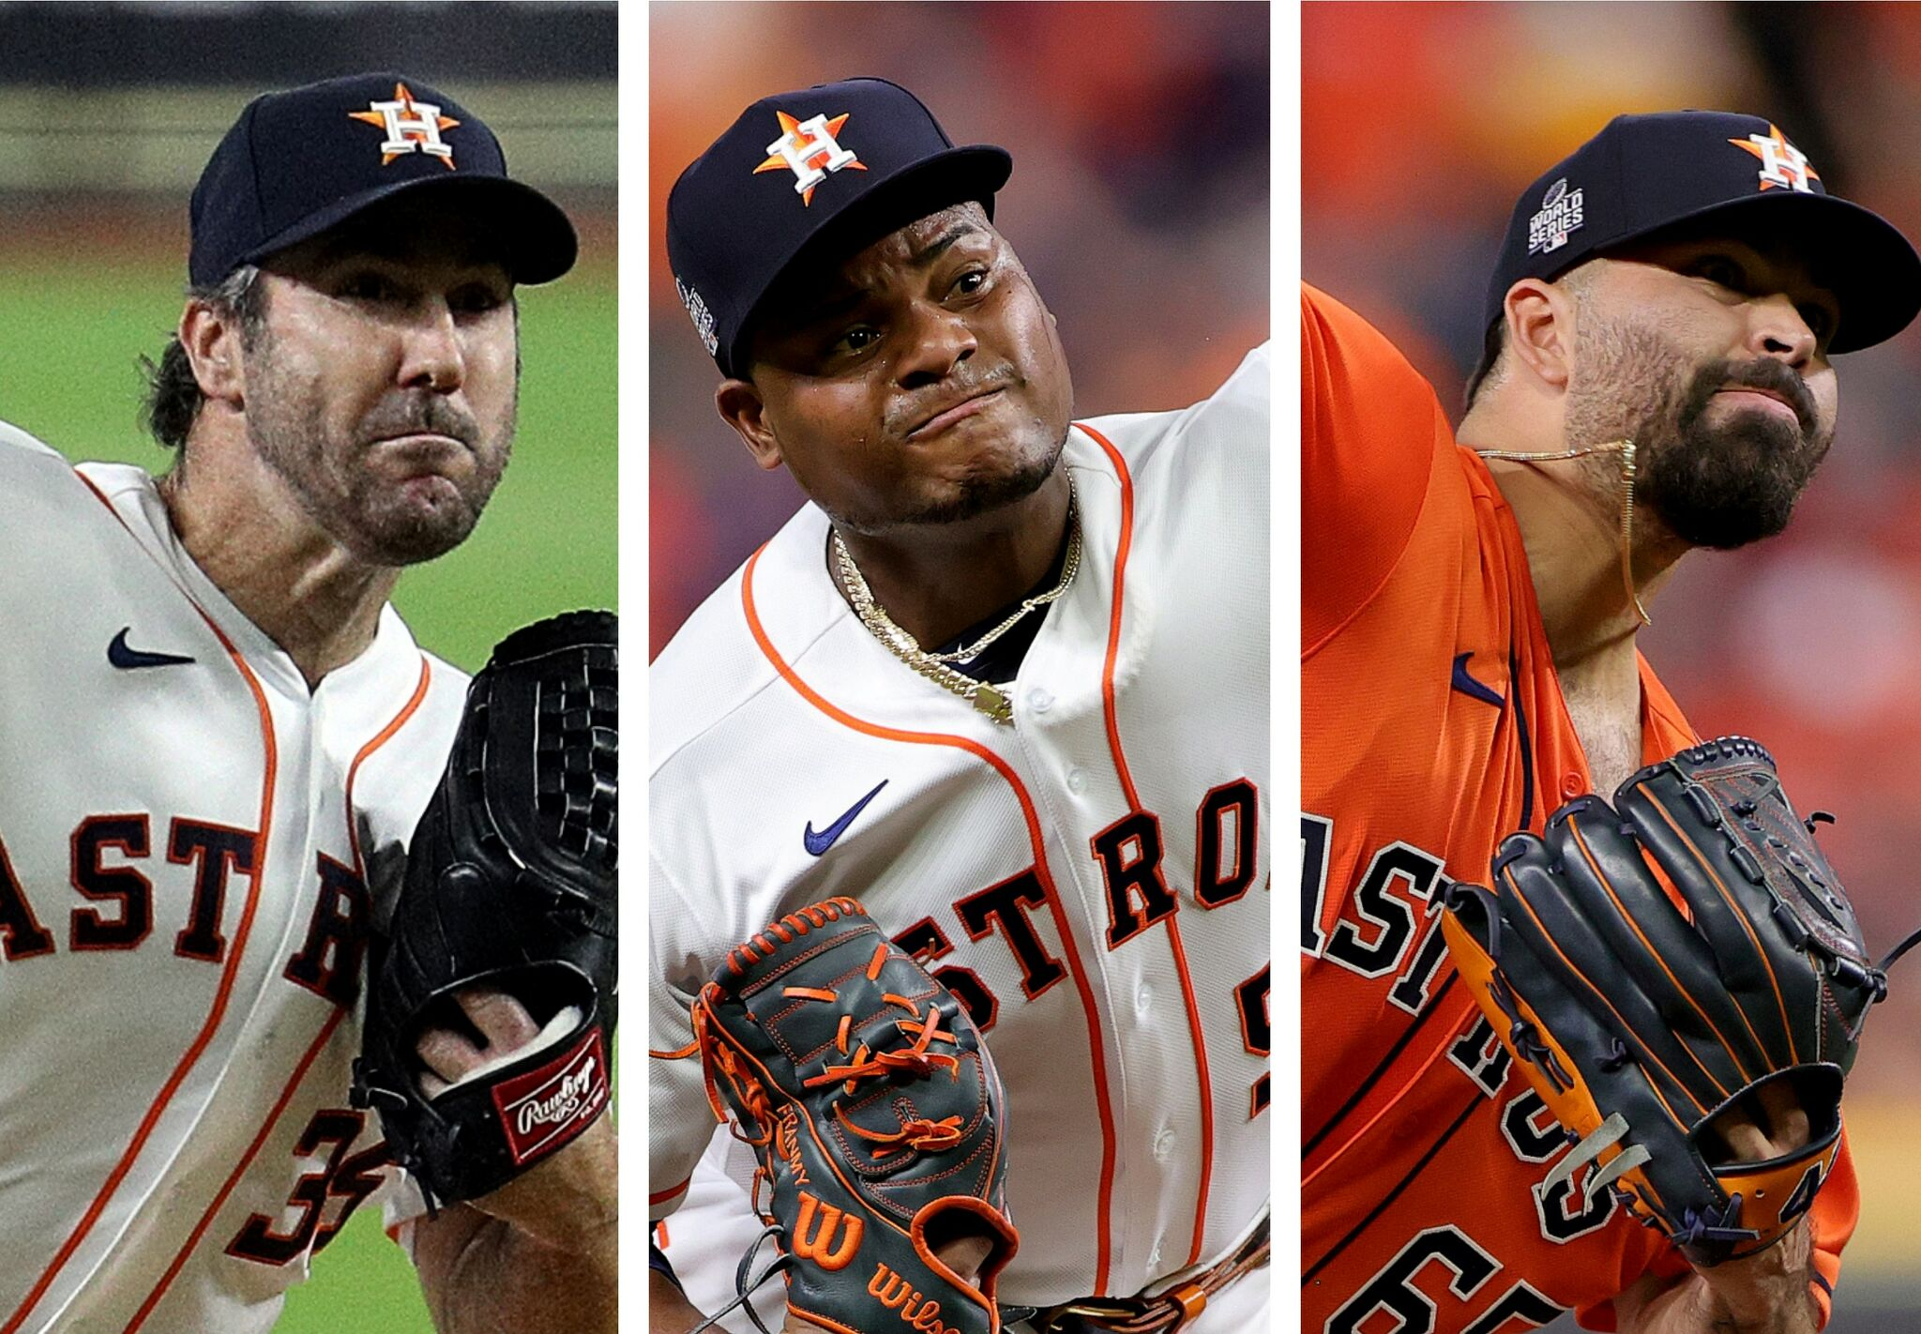
There is a strong relationship between Team ERA and Playoffs
Angels team ERA is comparable with other playoff caliber teams
So why are they struggling?
Notes:
Ben

Slide 13
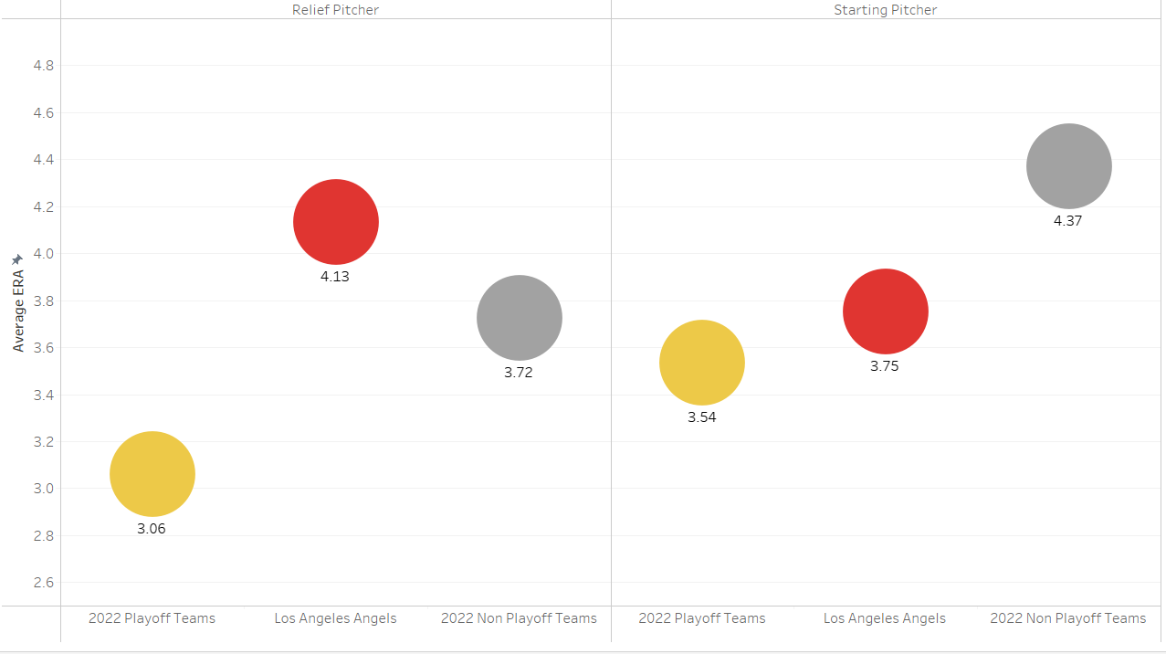
Starting Pitching -> Playoff Quality
BUT Relief Pitching -> Not Playoff Quality
RP
SP
Starting pitcher’s ERA is slightly above playoff teams
Reliever ERA of over 4.0
Bottom quarter of the league
Starters are giving the Angels a chance to win but the bullpen is blowing leads
Notes:
Ben

Slide 14
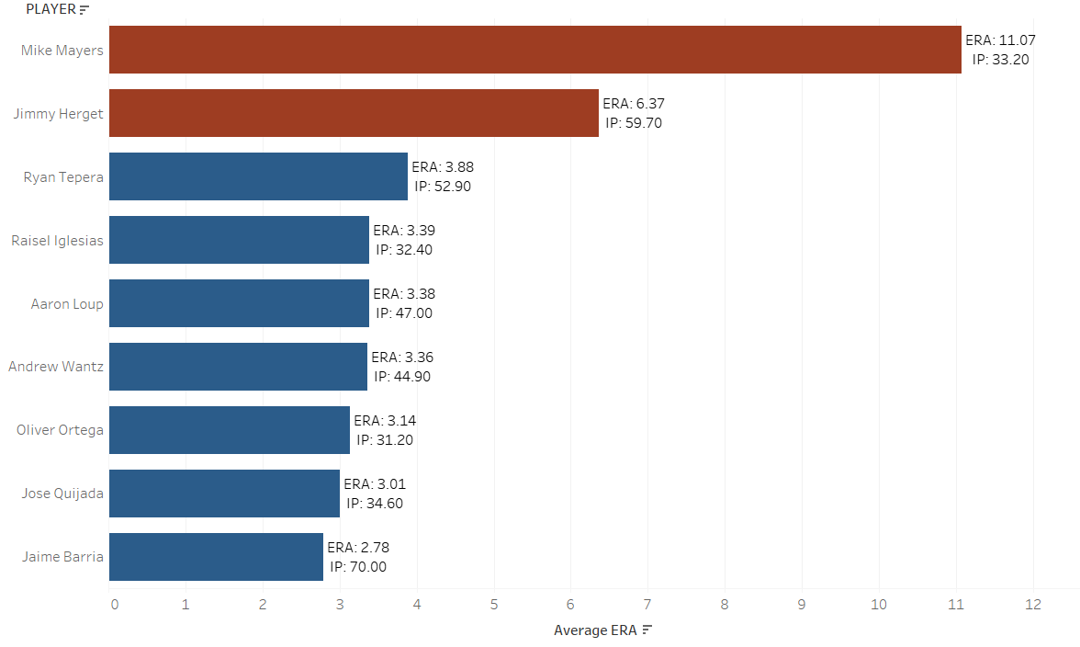
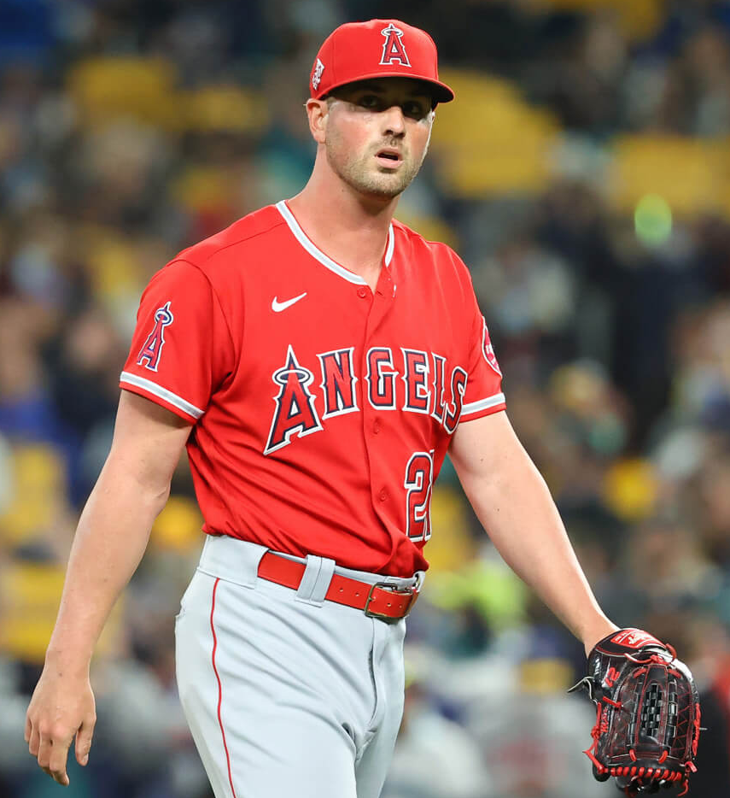
The Angels need to reevaluate their relief pitchers
Mike Mayers and Jimmy Herget
Relief Pitchers with more than 20 Innings Pitched
Mike Mayers and Jimmy Herget have each pitched a substantial number of innings with poor results
Both have ERAs 3 points higher than all other relief pitchers with more than 20 innings
Notes:
Reue

Slide 15
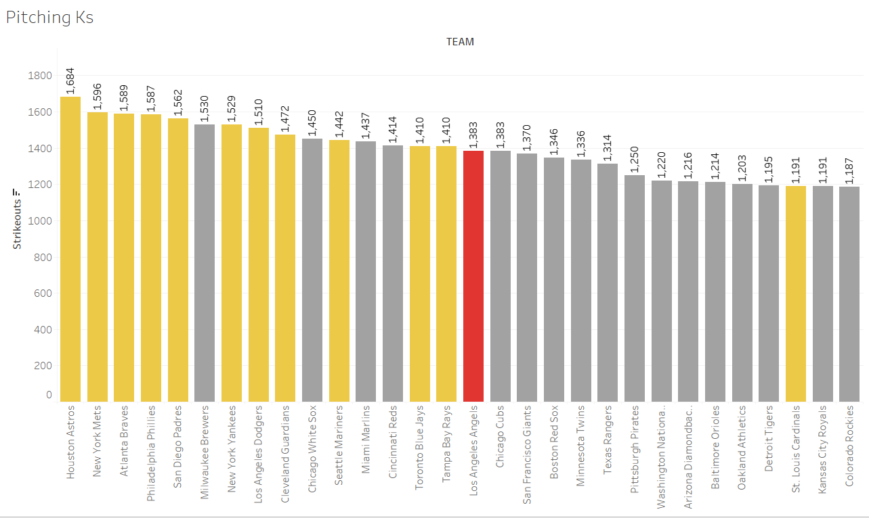
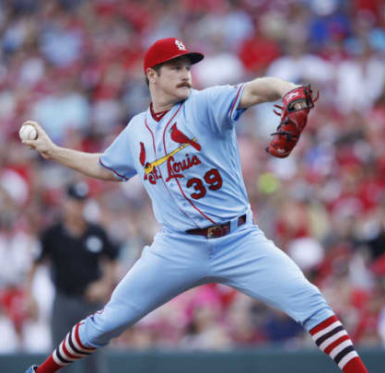
What style of pitchers should they target? Higher strikeouts lead to regular season success
Angels are 16th in the league in strikeouts (1383)
Strikeouts have a weaker correlation than ERA
Notes:
Reuben

Slide 16
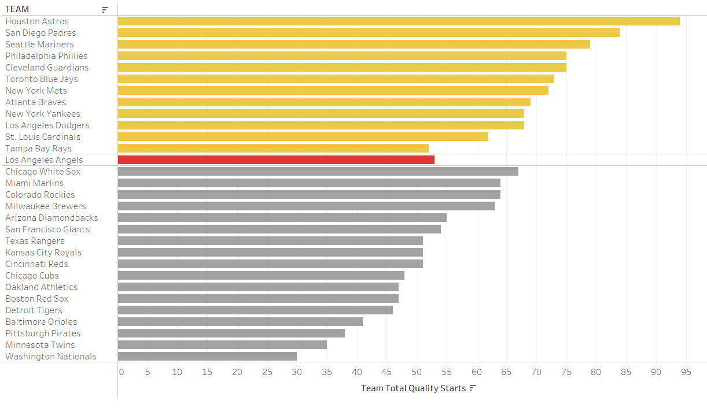
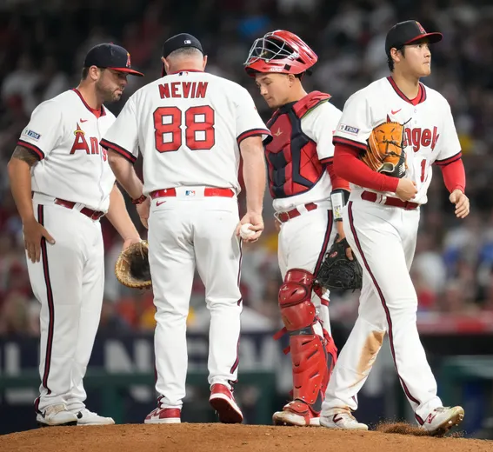
Quality Starts -> Playoffs
Angels starting pitching ERA is strong, but they are not pitching deep into games
Quality Starts
Require 6+ Innings and 3 ER or less
Notes:
Jack

Slide 17
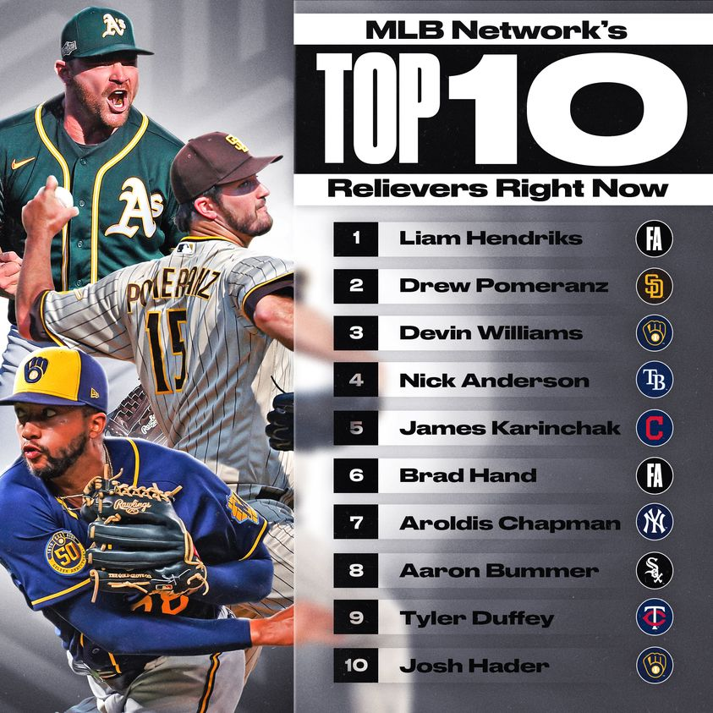
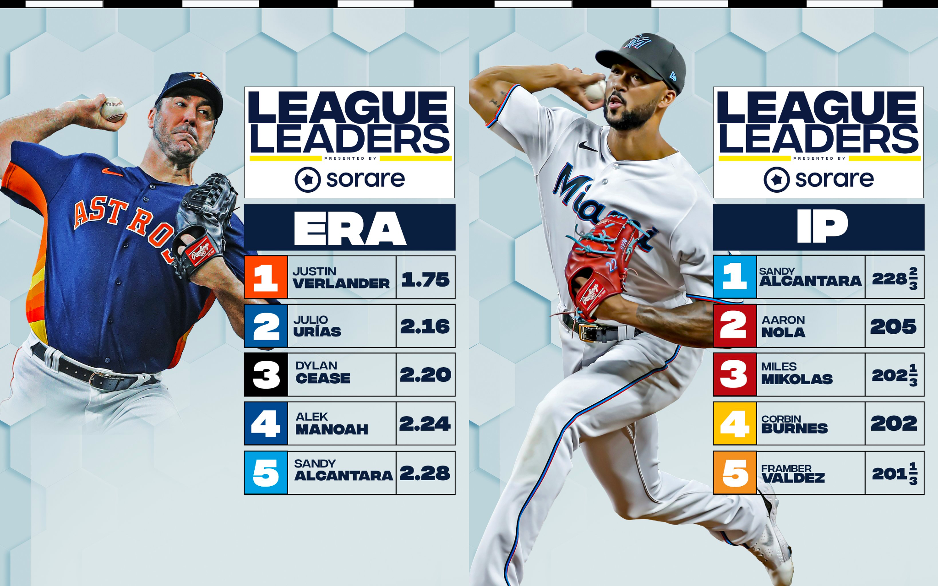
Recommendations for Pitching
Allocate more payroll to acquire another top Starting Pitcher
Allow starters to pitch deeper into games
Acquire strikeout heavy Relief Pitcher
Notes:
Jack

Slide 18
References
https://www.stevetheump.com/Payrolls.htm
https://www.spotrac.com/mlb/payroll/
https://www.baseball-reference.com/teams/ANA/index.shtml
https://www.mlb.com/standings

